Slide 2
Pairwise Testing in Agile World
Classic Combinatorial Test case design technique that can be applied to agile testing to save testing cost & time.

Slide 3

How many combinations does it take to test this?

Slide 4
Four fundamental challenges of software testing Source : Cem Kaner
Complete testing is impossible
Testers misallocate resources because they fall for the company’s process myths
Test groups operate under multiple missions, often conflicting, rarely articulated
Test groups often lack skilled programmers, and a vision of appropriate projects that would keep programming testers challenged

Slide 5
Complete testing is IMPOSSIBLE (Cem Kaner)
Test every possible input to every variable
Test every possible combination of inputs to every combination of variables
Test every possible sequence through the program
Test every hardware / software configuration, including configurations of servers not under your control
Test every way in which the user might try to use the program

Slide 6
Motivation for Pairwise Testing
Wallace and Kuhn of NIST (National Institute of Standards & Technology) determined that 98% of the reported software defects in recalled medical devices could have been detected by testing all pairs of parameter settings.
D.R. Wallace, D.R. Kuhn, “Failure Modes in Medical Device Software: An Analysis of 15 Years of Recall Data,” Intl. Journal of Reliability, Quality, and Safety Engineering, vol. 8, no. 4.

Slide 7
Essence of Pairwise Testing
Parameter Name | Values | No of Values
Age | 10, 14, 30, 50 | 4
Gender | Male, Female | 2
Certainty | Probable, Doubtful, Possible, Established, Suspected | 5
Severity | Minor, Moderate, Major | 3
Food | True, False | 2
Ethanol | True, False | 2
Medication | COUMADIN 10 MG ORAL TABS, ASPIRIN 325 MG ORAL TABS, STENDRA TABS, ABILIFY TABS | 4
Total Possible Configurations:
4 x 2 x 5 x 3 x 2 x 2 x 4 = 1920

Slide 8
Software Failure Analysis
The simplest bugs in a system are generally triggered by a single input parameter
E.g., failure occurs if
pressure < 10 (1-way interaction)
The next simplest category of bugs consists of those dependent on interactions between pairs of parameters
E.g., failure occurs if
pressure < 10 & volume > 300 (2-way interaction)

Slide 9
Software Failure Analysis
Bugs involving interactions between 3 or more parameters are progressively less common, while at the same time progressively more expensive
Most complex failure required 4-way interaction

Slide 10
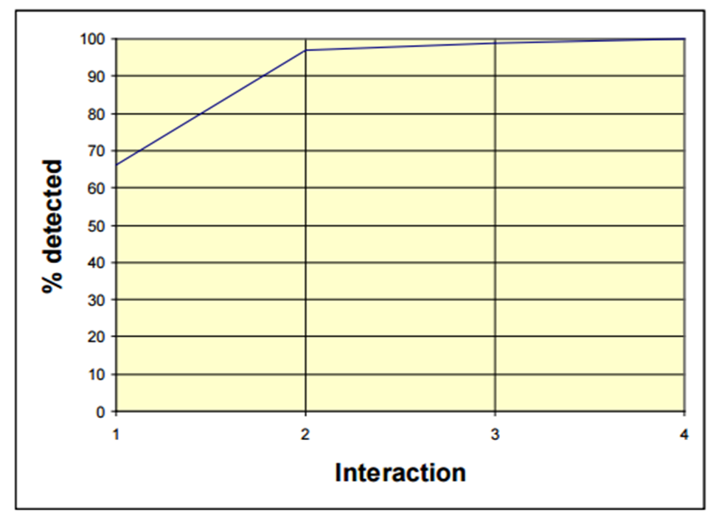
Software Failure Analysis – Medical Devices

Slide 11
The Pairwise Technique
Don’t test all combinations. Test all pairs.
Pairwise testing – an approach to combinatorial testing that executes a pairwise test data set.
Pairwise test data set - A set of test cases that covers all combinations of the selected test data values for every pair of a system’s input variables.
Pairwise testing is also known as 2-way testing; other approaches include 3-way, 4-way, … , n-way.

Slide 12
An Example
X={A, B} Y={C, D} Z={E, F}
System S
There are 2^3 = 8 Combinations

Slide 13
All Combinations (Test Cases)
X={A, B} Y={C, D} Z={E, F}
Test ID | X | Y | Z
T1 | A | C | E
T2 | A | C | F
T3 | A | D | E
T4 | A | D | F
T5 | B | C | E
T6 | B | C | F
T7 | B | D | E
T8 | B | D | F

Slide 14
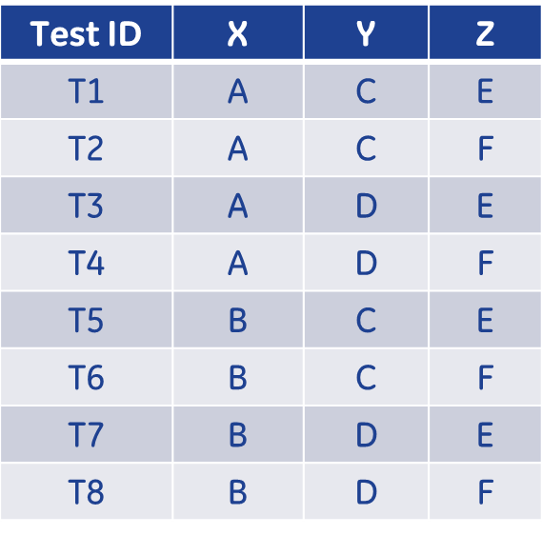
Pairwise Reductions by hand
You can get rid of test case T2, since
AC is covered in T1
CF is covered in T6
AF is covered in T4
What other test cases can you get rid of?

Slide 15
Pairwise Reductions by hand
Test ID | X | Y | Z
T1 | A | C | E
T4 | A | D | F
T6 | B | C | F
T7 | B | D | E

Slide 16
Pairwise Reductions
Number of inputs | Number of selected test data values | Total Number of combinations | Size of pairwise test set
3 | 2 | 8 | 4
7 | 2 | 128 | 8
13 | 3 | 1594323 | 18
40 | 3 | 1.2 x 10¹⁹ | 21

Slide 17
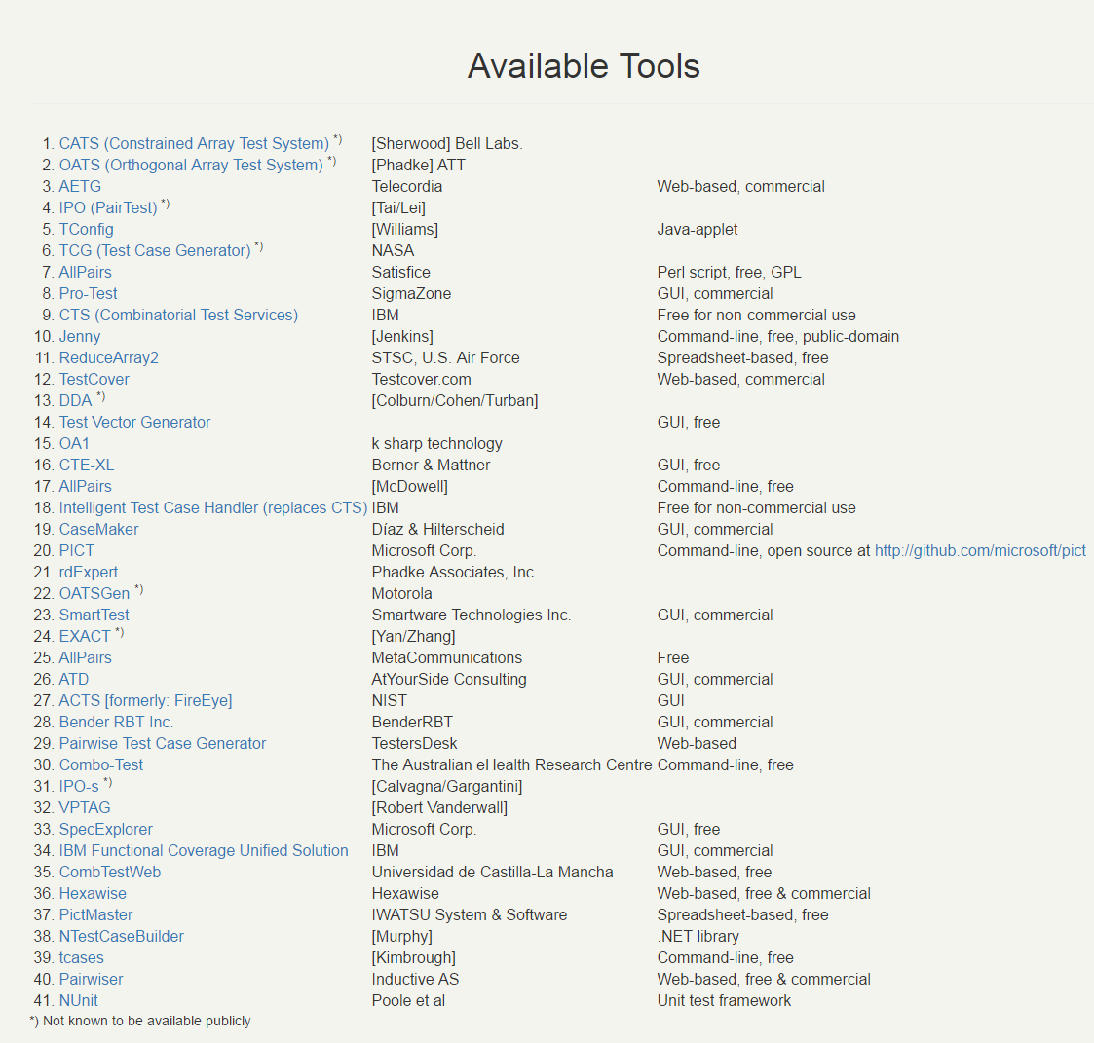
Pairwise Reduction - Tools

Slide 18
TestCover
Commercial off the shelf tool
Algorithm based on Bell Labs research
Mathematically optimal among other tools
Determines test scenarios/cases based on input
Test Factor
Test Factor Values
Documented Constraints
https://testcover.com/sub/index.php

Slide 19
TestCover Example
Test Factor | Number of Values | Test Factor Values
Operating system | 4 | XP, Vista, MacOS, Linux
Display resolution | 3 | Low, medium, high
Connection | 4 | wi-fi, dsl, cable, lan
Browser | 4 | IE, Firefox, Opera, Safari
Application | 3 | App1, App2, App3
Total Configurations = 576

Slide 20

The TestCover Request
Header
Test Factor
Partition
Test Factor Values

Slide 21
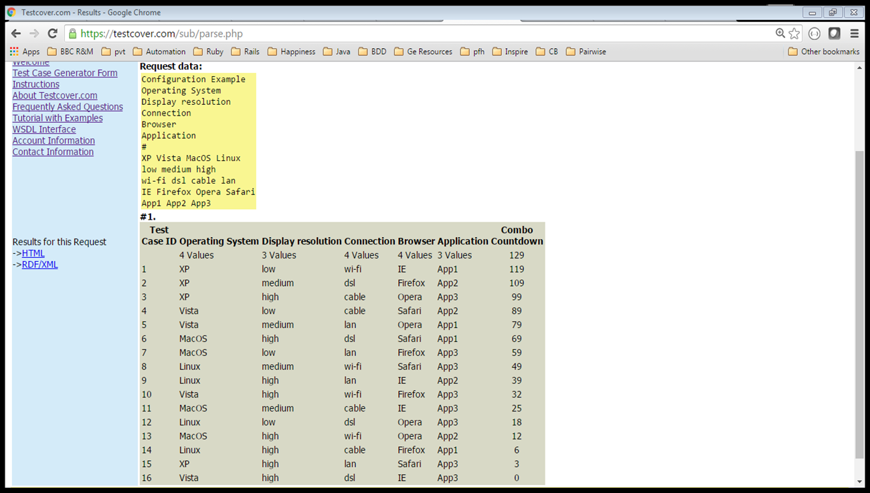
The Reduced Pairwise Subset

Slide 22
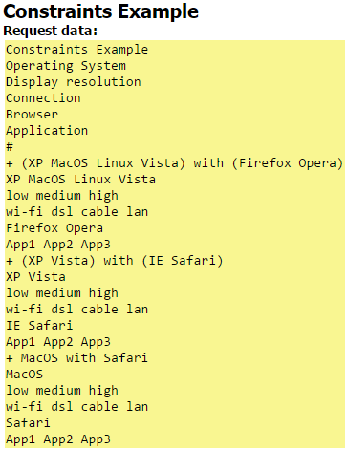
Another Example – with Constraints
Header
Block
Partition
Block
Block

Slide 23
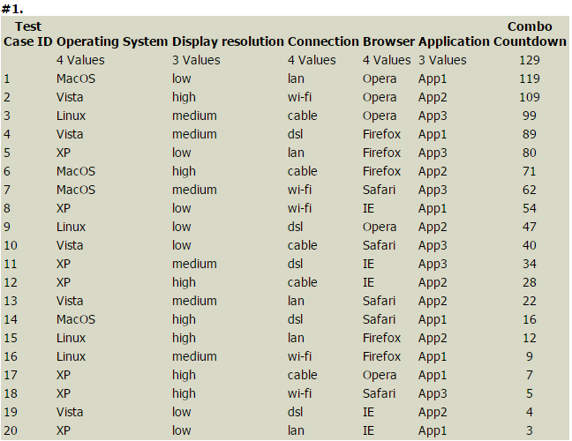
The Result

Slide 24
Caveat
Pairwise testing will not be effective if you choose the wrong input test data values
We often assume defects can be immediately observed. In fact, there may be slow internal corruption occurring
High-use (including defaults) or high-risk combinations probably don’t get enough attention
Note: These dangers are not exclusive to pairwise testing. They affect all testing efforts

Slide 25
References
http://www.pairwise.org
https://testcover.com/sub/index.php
http://csrc.nist.gov/groups/SNS/acts/documents/verify07.pdf
http://www.bcs.org/upload/pdf/lcopeland-070312.pdf

